Slide 1
IOT based Smart Irrigation System
Final Year Project
Submitted by
Mureed Qasim Shah
Supervisor
Mr. Muhammad Usama

Slide 2
Outlines
Introduction
Literature Review
Methodology
Results
Discussion
Environmental Benefit
Conclusion
Future Work
Reflection on Learning
References

Slide 3
IoT based Smart Irrigation System
Introduction
Agriculture as backbone 70% of the Population is related to Agriculture[5] 5th , 7th and 10th largest producer of Sugarcane, Wheat and Rice [5] Huge part in GDP

Slide 4
IoT based Smart Irrigation System
Motivation
Wastage of water during Irrigation Lack of knowledge about Irrigation schedule Proper Irrigation System

Slide 5
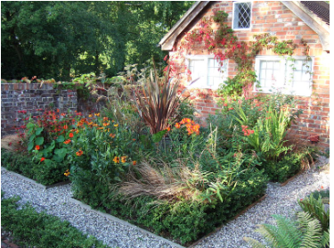
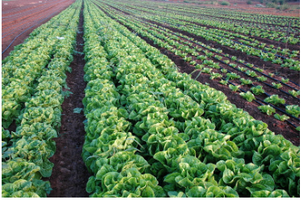
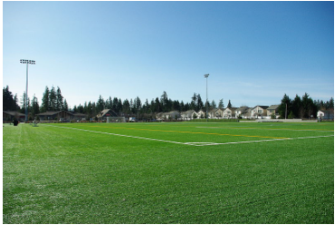
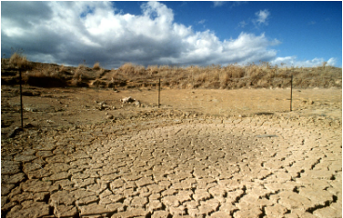
IoT based Smart Irrigation System
Business Scope
Agriculture Household Gardening Research and Forecasting Over Irrigation for Sporting Field

Slide 6
IoT based Smart Irrigation System
Literature Review
Drawbacks of their Project: 1 soil moisture sensor [1] What their project will do if it starts to rain and motor pump is ON [2] No integration of Rain and Soil moisture Sensor [3] No information about Water drainage system [4] No remote observation of sensors values [5]

Slide 7
Methodology
Initial Problem
Review Literature
Simulation
Component Testing
Review and test
Web Design
Complete Design
Build and test small System

Slide 8
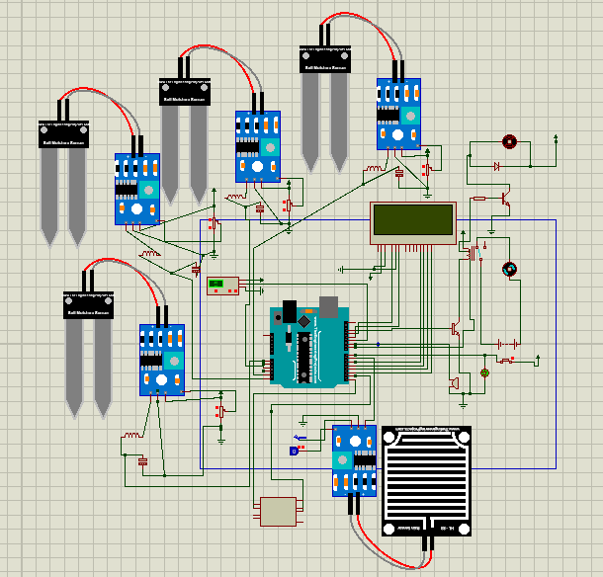
Circuit Diagram
Block Diagram

Slide 9
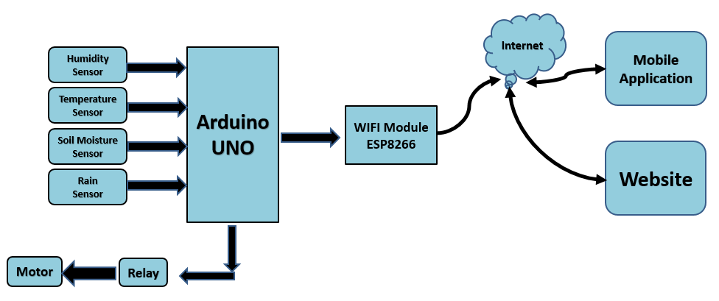
Block Diagram
Block Diagram

Slide 10
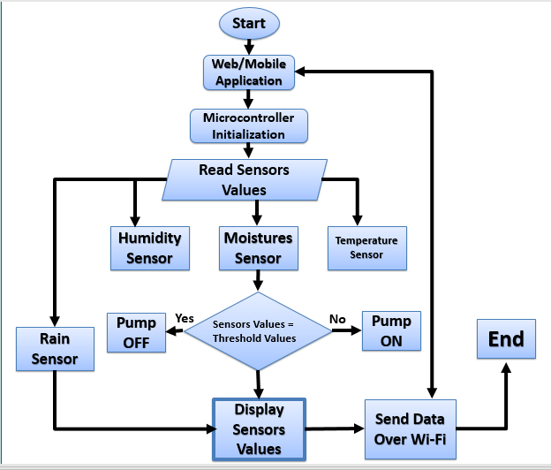
Block Diagram
Block Diagram

Slide 11
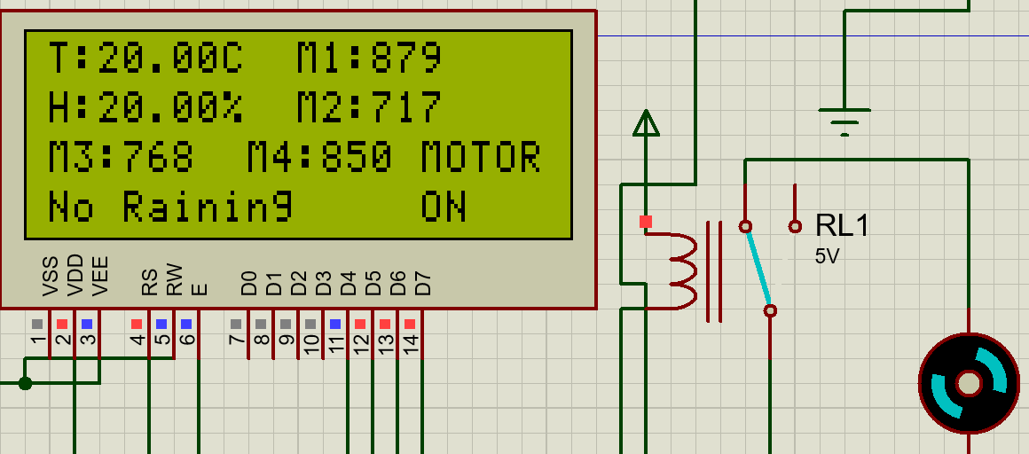
Condition 1 : Motor ON
Results & Discussion
Soil Moisture Sensors Values > 700 & No Raining

Slide 12
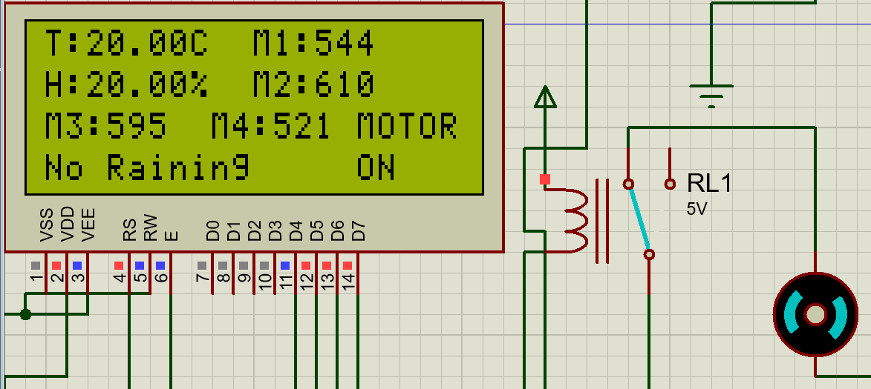
Condition 2 : Motor ON
Soil Moisture Sensors Values between 300 to 700 & No Raining

Slide 13
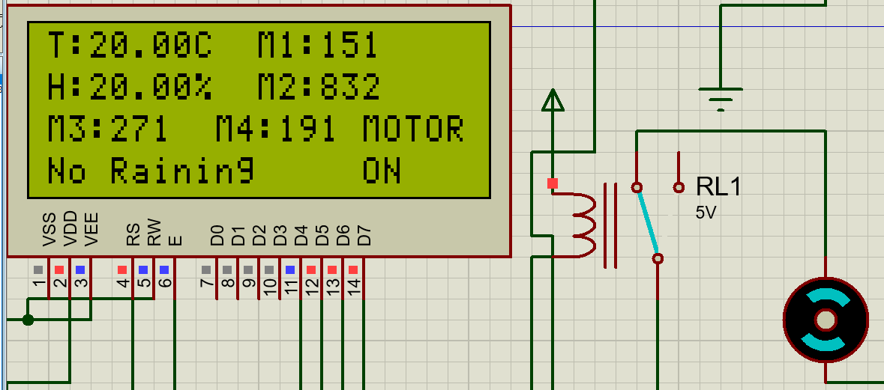
Condition 3 : Motor ON
If we operate on condition when all sensor values > 700 One part of the soil is dry Anyone Soil Moisture Sensor Value > 700 & No Raining

Slide 14
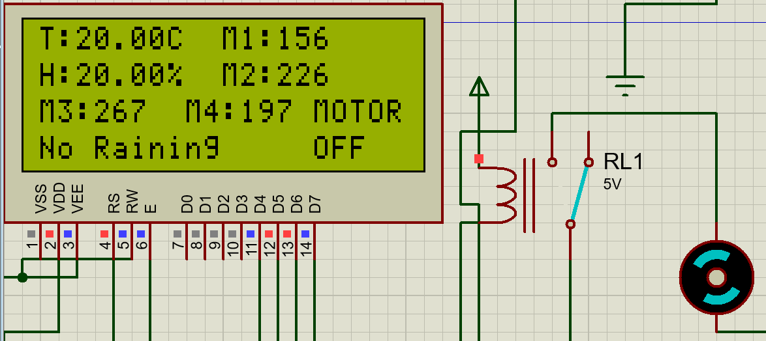
Condition 4 : Motor OFF
Soil Moisture Sensors Values < 300

Slide 15
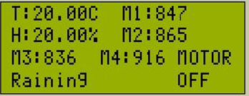
Condition 5 : Motor OFF
Soil Moisture Sensors Values > 700 & Raining

Slide 16
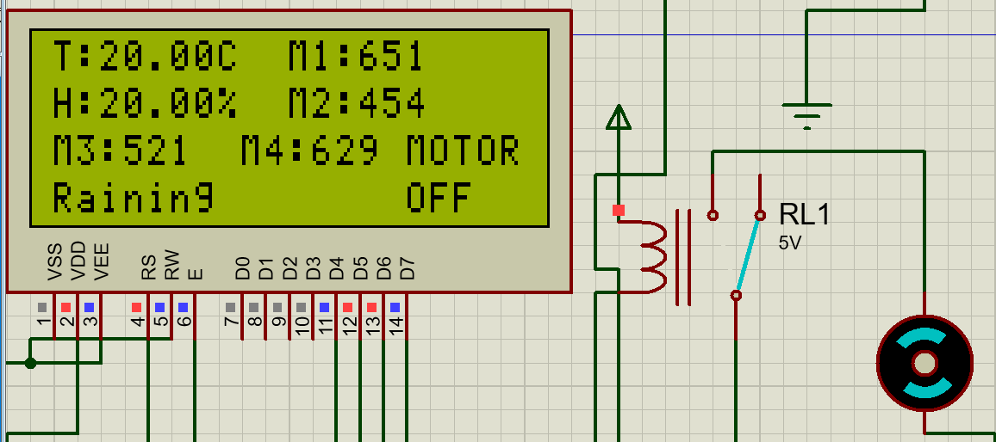
Condition 6 : Motor OFF
Soil Moisture Sensors Values between 300 to 700 & Raining

Slide 17
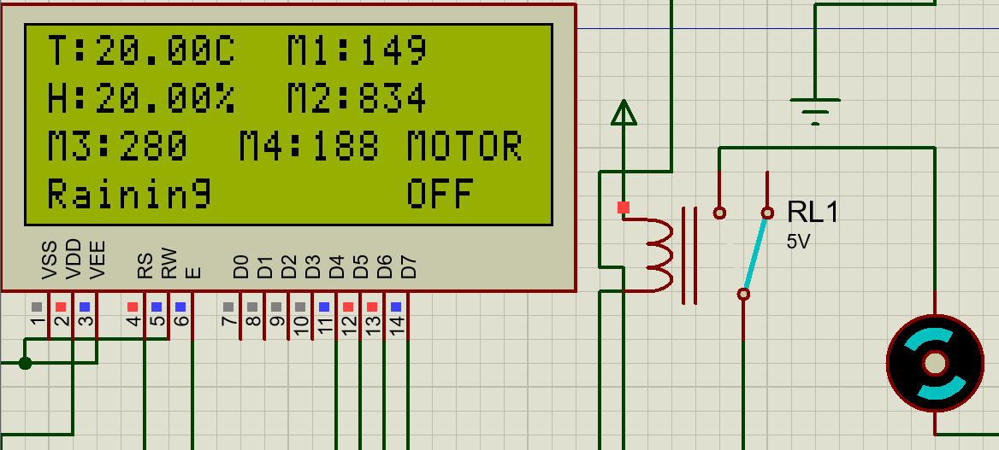
Condition 7 : Motor OFF
Anyone Soil Moisture Sensor Value > 700 & Raining

Slide 18
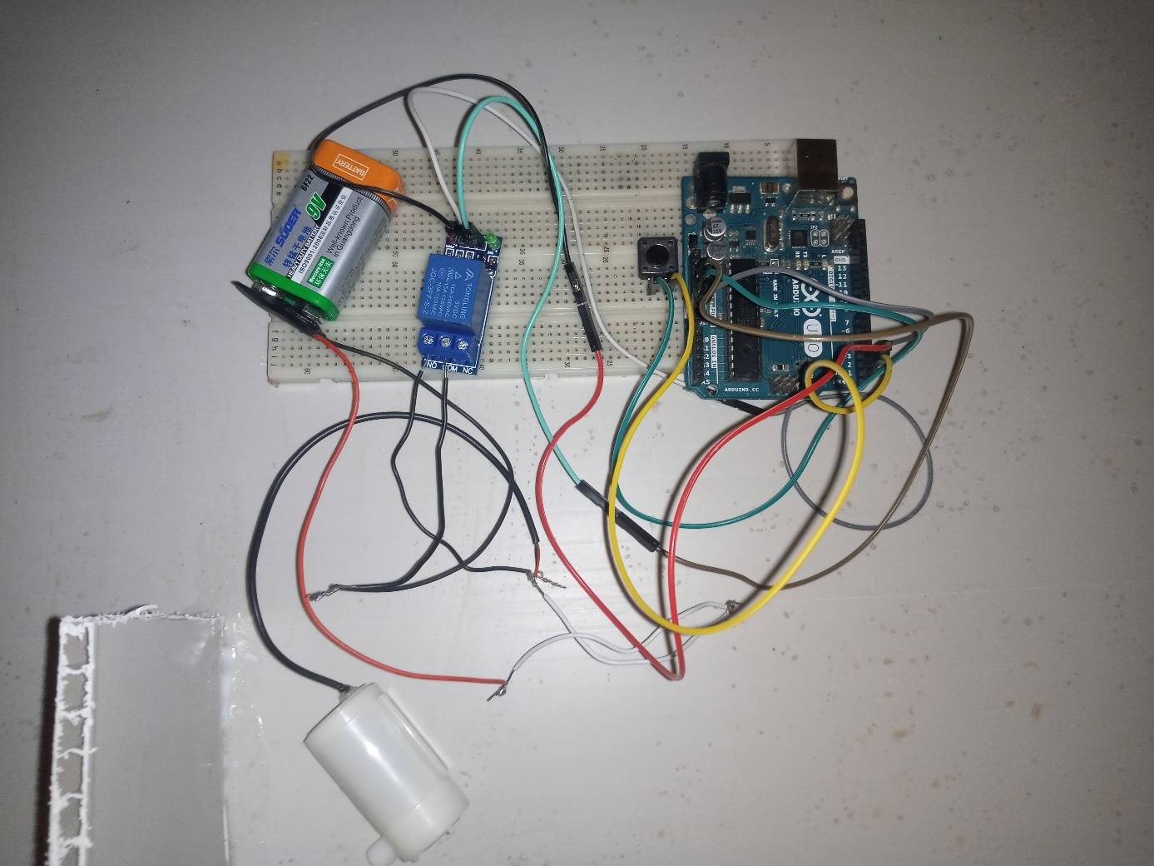
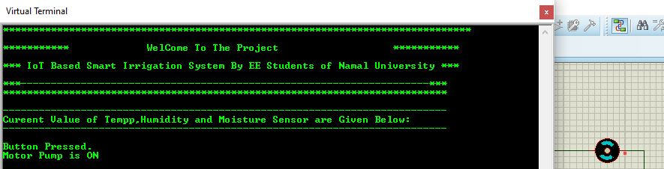
Water Drainage System
Water Drainage System
Proposed a water drainage system
Dig a small pit next to our field
Use that water for irrigation

Slide 19
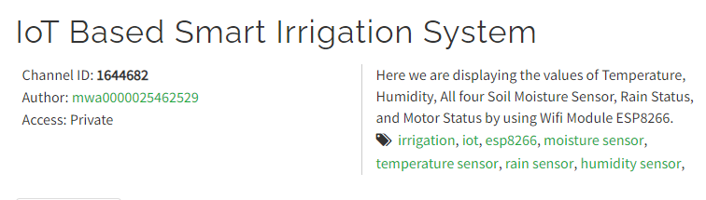
Dashboard Design
ThingSpeak Web Design

Slide 20
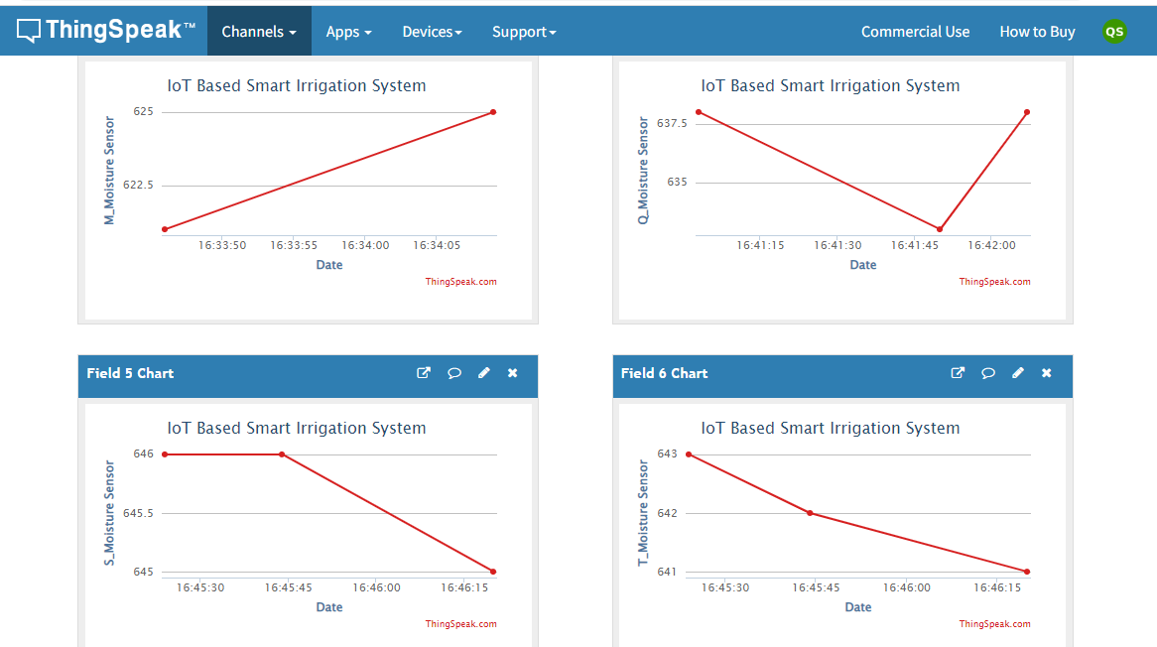
Reading the Sensor Data

Slide 21
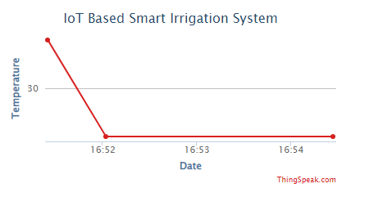
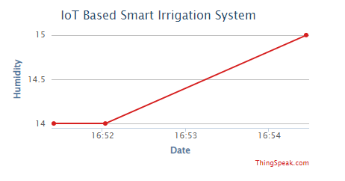
Reading the Sensor Data
Reading Temperature Value
Reading Humidity Value

Slide 22
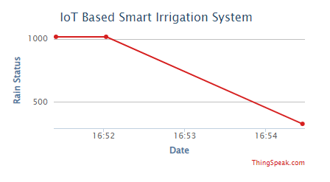
Reading the Sensor Data
Reading Rain Sensor Value

Slide 23
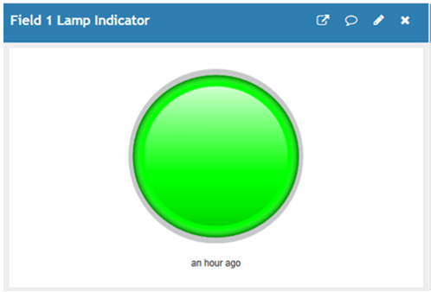
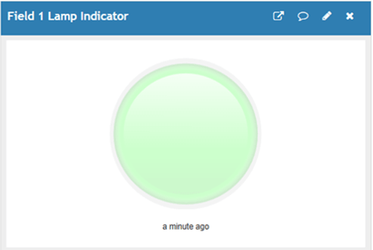
Reading the Sensor Data
Motor ON State
Motor OFF State

Slide 24
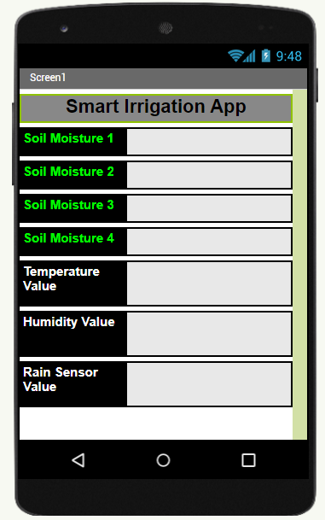
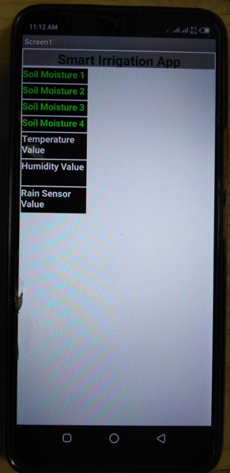
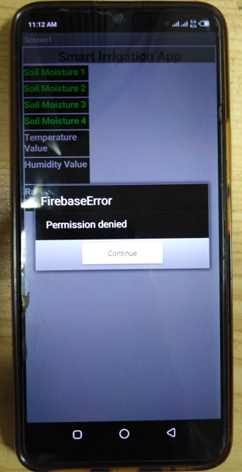
Mobile App Design

Slide 25
IOT Based Smart Irrigation System
Limitation
The farmer must have an excess to the mobile phone or laptop. The farmer must have a strong internet connection. Unable to retrieve the data into Mobile app from ThingSpeak

Slide 26
IOT Based Smart Irrigation System
Environmental Benefit
Reducing the wastage of water during Irrigation Reducing the human effort for the farmer Maintaining the right level of moisture of the soil Increasing the productivity

Slide 27
IOT Based Smart Irrigation System
Conclusion
New Approach for Irrigation Spread awareness among the farmers Government needs to test and verify these system on small area Possible Implementation of the new approach

Slide 28
IOT Based Smart Irrigation System
Future Work
Using solar energy Adding the AI system to predict the production of Crops Using the agriculture drones Predict weather forecasting using ML models

Slide 29






Reflection on Learning
Technical Learning
By doing this project, I have learned and have a great command on these technology

Slide 30
IOT Based Smart Irrigation System
References
[1] Moller, J. (2010). A Versatile Technology in automation of agriculture machinery. Computer virsion, 17. [2] Design and Implementation of Automatic Plant Watering System “Archana and Priya” presented at International Journal of Advanced Engineering and Global technology, vol- 04, Issue-01, Jan-2016. [3] Sensor Based Automated Irrigation System with IOT “Karan Kansara and Vishal Zaweri,” presented at International Journal of Computer Science and Information Technologies, vol-06, 2015. [4] C.H.Chavan and V.Karnade, “ Wireless Monitoring of Soil moisture, Temperature and Humidity using Zigbee in Agriculture” presented at International Journal of Engineering Trends and Technology (IJETT), vol-11, May- 2014. [5] Asian Journal of Science and Technology Vol. 10,Issue 0 6, pp.9756-9768, June, 20.

Slide 31
IOT Based Smart Irrigation System
Thank You
Any Questions!

